Slide 1
Inference Systems:
Speculative Decoding
Introduction to Deep Learning: Class 8.2

Slide 2
Speculative Decoding: Key idea
Autoregressive decode is slow and memory bound. Speculative decoding is an inference trick for reducing the number of expensive target-model decode iterations.
Key idea: guess several future tokens cheaply using a draft mechanism, then ask the full model to verify them in one parallel pass.

Slide 3
Speculative decoding: Example
Current context: The capital of france is
Draft: Paris. It
Target model verifies all three tokens in parallel.
Is Paris acceptable after The capital of france is?
Is . acceptable after The capital of france is paris ?
Is It acceptable after The capital of france is paris. ?
If all three tokens are accepted, decode moves forward by three tokens after one verification pass

Slide 4
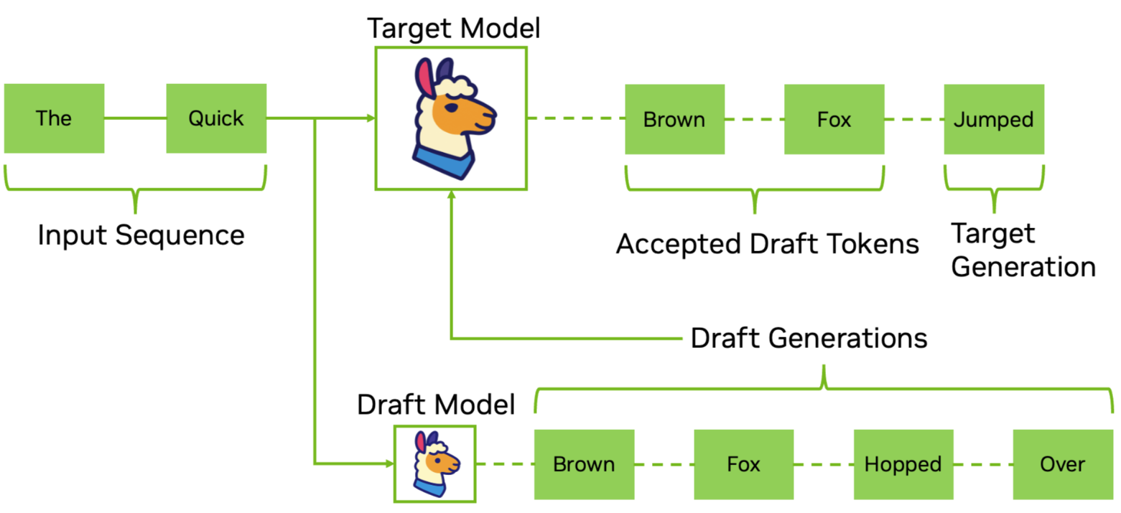
Speculative Decoding

Slide 5
Speculative Decoding
But isn’t verifying 3 tokens the same as running decode 3 times?
No, because all 3 tokens can be processed in a single forward pass. This is more like prefill for a prefix of length 3.
Speculative decoding is beneficial if:
Cost(draft + verify k tokens) < Cost(k separate decode steps)
Benefit depends on:
Number of draft tokens
Acceptance rate
Cost of draft mechanism
Target model size..

Slide 6
Accept/Reject logic
Greedy: if the target model’s top choice matches the draft token, accept it.
Example 1:
Draft proposes: [Paris, ., It]
Target top tokens: [Paris, ., It]
Accept all three
Example 2:
Draft proposes: [Paris, is, beautiful]
Target top tokens: [Paris, ., It]

Slide 7
Accept/Reject logic
One can also use non-greedy techniques, that preserves the exact target distribution..

Slide 8
Draft mechanisms
Model-based:
Use a smaller model as a draft model
Medusa:
Use target model hidden states + lightweight speculative head
Maintain a confidence score of the draft sequence. Generate longer sequences of more predictable tokens and shorter sequences of more complex text
Model-less:
Suffix decoding: Find useful suffix matches of varying length, often using a suffix tree or similar data structure built on previously generations, and use the observed continuations to build candidate speculative tokens.
Earlier: [X, Y, C, D, E, F, G, H]
Current: [A, B, C, D, E, F]
Suffix tree may propose: G,H

